Slide 1


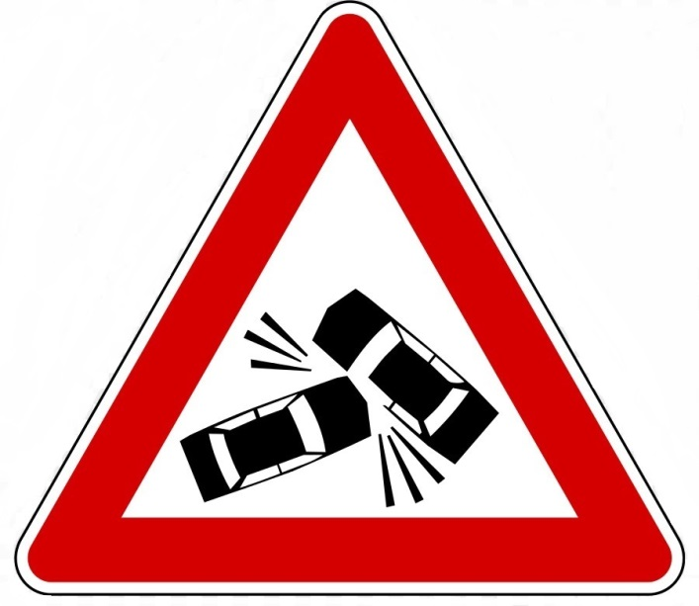
Traffic Accidents Syracuse, MS Data Science
Professor Jon Fox
Stephanie Cruz
Leland Ball
Maryse Khoury
Jacob Arluck
Veasna Oum

Slide 2
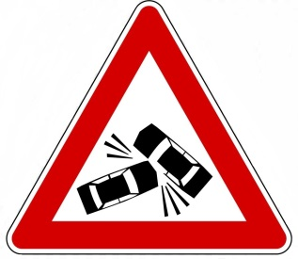
Introduction
Every year, some 30,000 automobile fatalities are recorded in the United States
Far more non-fatal automobile accidents occur in this same time period
Alcohol, inexperience, and inattention are well-known factors affecting the likelihood of these accidents and fatalities, but do not account for every incident on the road

Slide 3
Problem Statement
This project aims to identify factors that play a significant role in accidents
The hope is that lives and property would be saved if steps are taken to combat each source of automobile incidents
These steps include: additional stop signs or traffic lights, additional investment in EMS services by local government, and additional patrols for certain areas or during times of severe weather

Slide 4
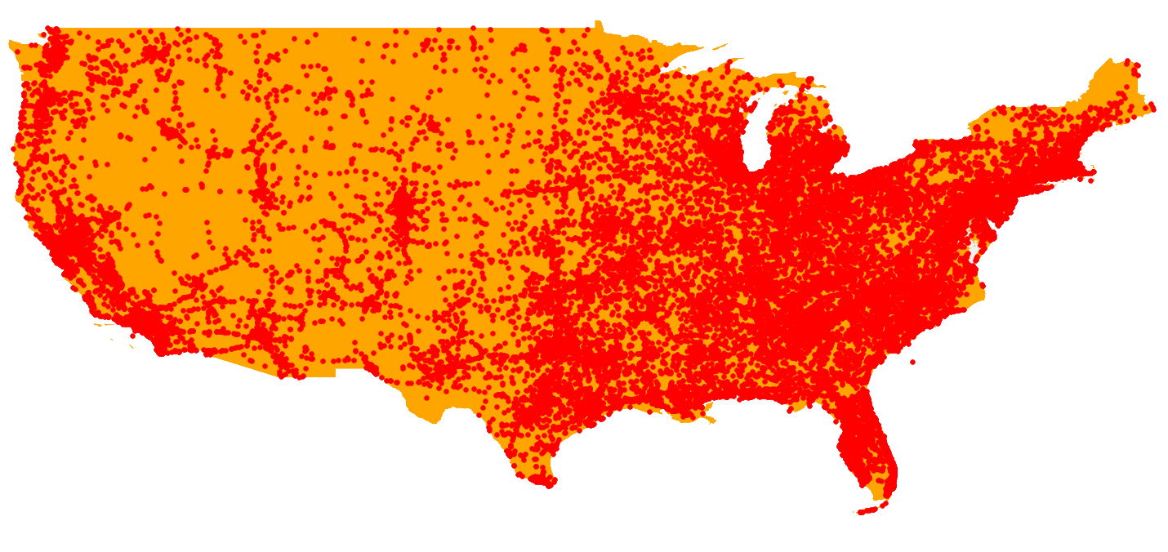
Data
Our first dataset comes from the US Department of Transportation - National Highway Traffic Safety Administration (NHTSA)
Traffic Fatalities
Entire USA
2018
The second dataset is: US traffic accidents compiled from traffic monitoring services
Traffic Accidents by severity
Entire USA
2016-2020
2018 Traffic Fatalities (NHTSA)

Slide 5
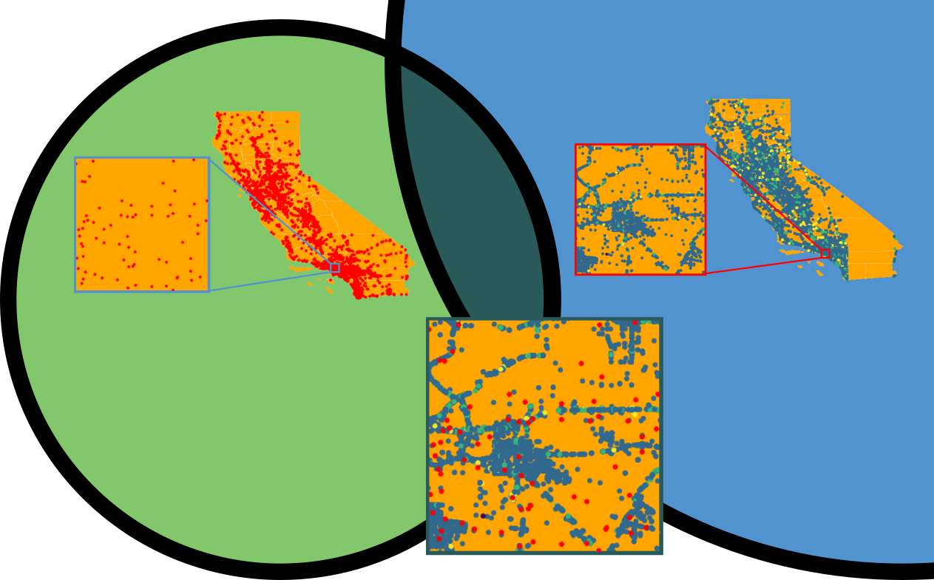
Fatalities
Accidents
Overlap:
1291 incidents
US Department of Transportation - National Highway Traffic Safety Administration (NHTSA) 2018 Fatalities
This data set measures 33,654 rows by 609 columns contained within 27 tables
US traffic accidents compiled from traffic monitoring services
This data set measures 3.5 million rows by 49 columns
3.87% of Fatalities overlap with 0.15% of Accident data points

Slide 6
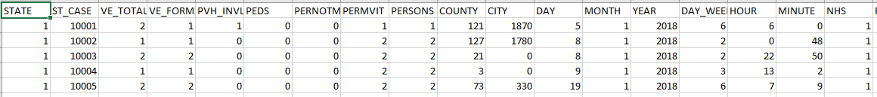
Data Preview
Analysis is based 2018 data for analysis consistency

Slide 7
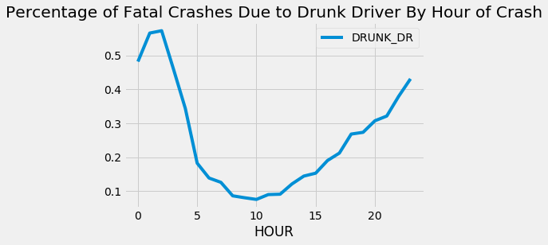
Data Visualization Alcohol and Accidents
Alcohol involved in about 28% of fatal crashes.
Unsurprisingly, most common for evenings, nights.

Slide 8
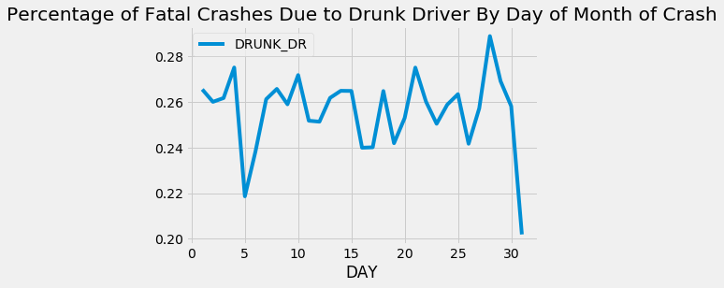
Alcohol and Accidents
Null hypothesis: does day of month correspond to alcohol rate?
Not a huge difference – but may reflect pay patterns, day of week.

Slide 9
Alcohol and Accidents
Drunk drivers more likely to kill selves than pedestrians, compared to non-drinkers
Drunk driving incidents are slightly more lethal than others.
Drunk drivers somewhat less likely to hit another car.
Highly significant!
Driver drunk | Avg. ped deaths | Avg tot fatalities | Avg add'l vehicles
NO | 0.29 | 1.07 | 0.57
YES | 0.09 | 1.11 | 0.47
Significance | p < 10^-229 | p < 10^-12 | p < 10^-24

Slide 10
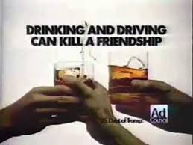

Alcohol and Accidents
Conclusion: Drunk drivers are selfish, both in motivation (conscientious drinkers don’t drive) and in practice (more likely to kill selves than others)
Best messages targeted at self-interest, rather than at sense of responsibility towards others.
Most drinking is at night!
1993 (potentially ineffective) 2019 (much better)

Slide 11

Fatality Factors: Market-Basket Analysis
What co-occurring events stand out among traffic fatalities?
A Market-Basket Analysis using the Apriori algorithm identifies rules that highlight the association of variables in the data
National Highway Traffic Safety Administration (NHTSA) Traffic Fatalities Dataset for 2018

Slide 12

Darkness: Deadlier for Pedestrians
If the weather is clear and a pedestrian was struck, then it is more likely that pedestrian was killed by a sober driver at night.
Weather | First Harmful Event |  | Sobriety | Lighting | Lift
Clear/Cloudy | Pedestrian Strike | -> | Sober | Dark (Lighted) | 2.81
RECOMMEND:
Promote high-visibility clothing and pedestrian situational awareness

Slide 13

Drunk Drivers Are Not Everything To Watch Out For
While drunk drivers cause substantial harm to others, their effect on pedestrians is less noticeable than that of sober drivers.
Sobriety |  | First Harmful Event | Lift
Drunk | -> | Curb Collision | 1.79
Drunk | -> | Tree Collision | 1.53
Drunk | -> | Rollover/Overturn | 1.46
Sober | -> | Pedestrian Strike | 1.25
Sober | -> | Cyclist Strike | 1.22
RECOMMEND:
Promote pedestrian awareness for possible injury during daytime by drivers otherwise driving sober

Slide 14
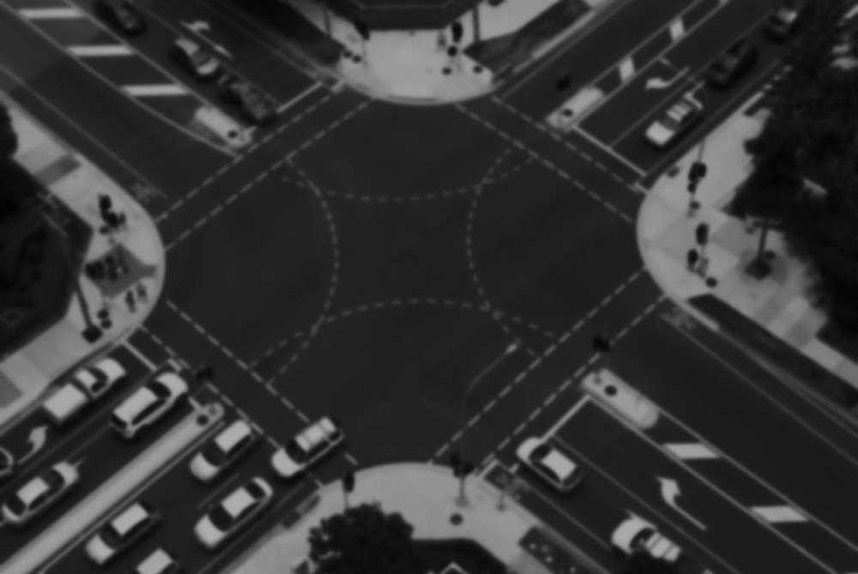
Rural and Urban Intersections Remain Dangerous
In darkness, even lighted intersections are the site of traffic fatalities. This effect can be seen in both urban and rural settings, though rules highlighting rural areas showed less of this effect, this effect also appeared during the day.
Intersection | Rural/Urban |  | Lighting | Lift
Four-Way | Urban | -> | Dark (Lighted) | 1.91
T-Intersect | Urban | -> | Dark (Lighted) | 1.68
Four-Way | Rural | -> | Daylight | 1.51
RECOMMEND:
Installation of warning signs for problematic intersections in both urban and rural settings

Slide 15
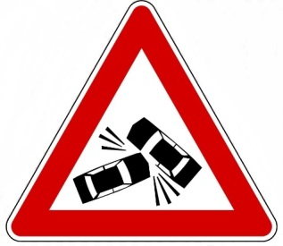
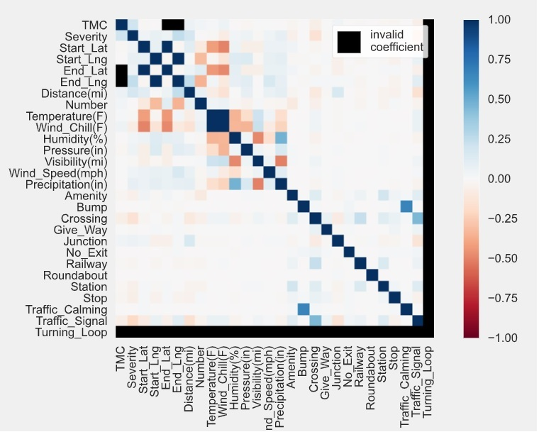
Time Series Analysis Data Scrubbing US Traffic Accident Dataset:
Check variables correlation
Drop columns with:
One categorical data value
Boolean columns with less than 0.1% distinct values
High percentages of missing values
Duplicated values
Drop rows with multiple missing values
Retrieve and merge missing Zip codes by searching their coordinates
Complete missing Time zones
3.5M rows x 17 columns

Slide 16
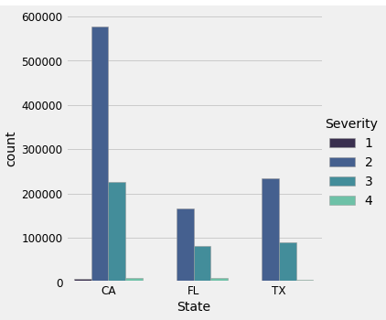
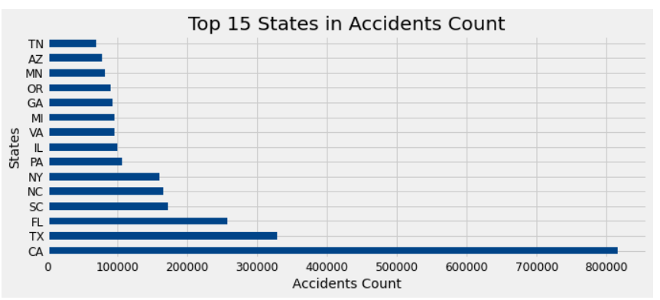
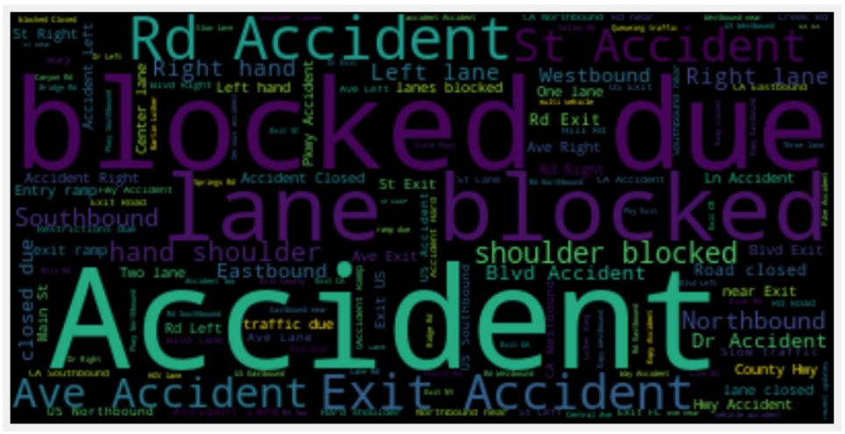
Time Series Analysis Data Exploration
Total accidents per time zone
Total accidents per state
Total accidents per severity
Most used words for accidents reported

Slide 17
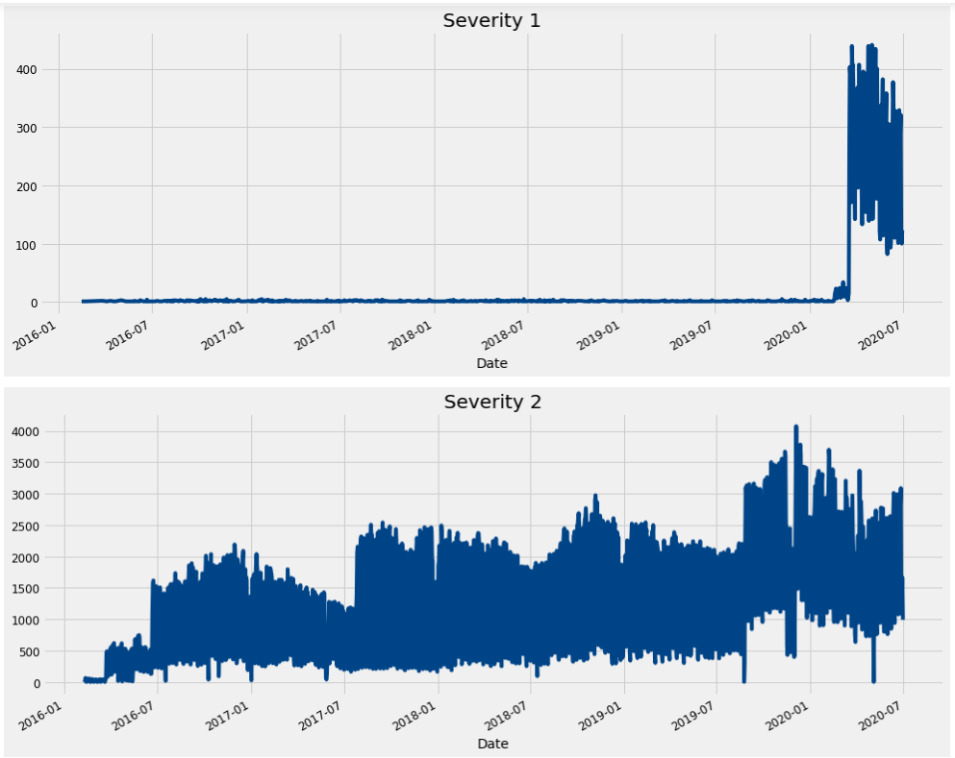
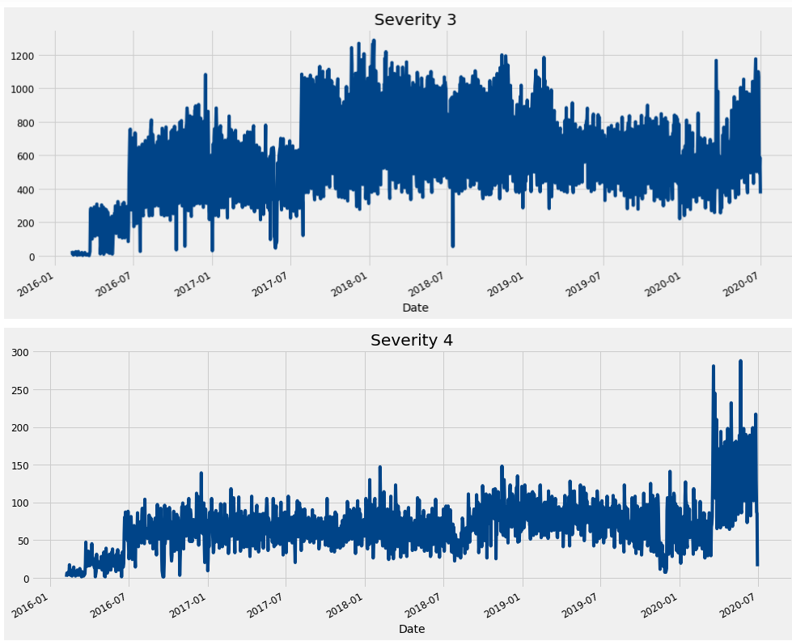
Time Series Analysis
Implemented ARIMA model
Severity Time Series Analysis

Slide 18
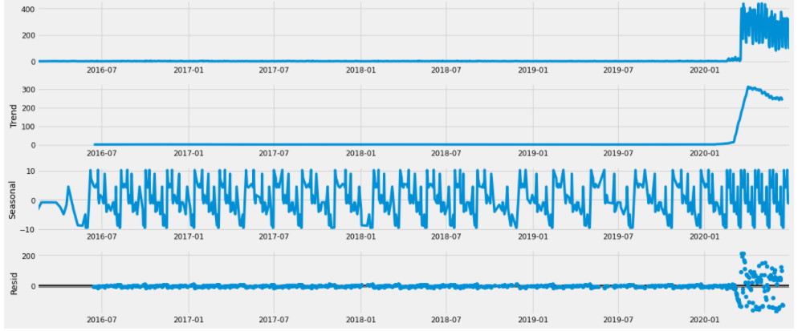
Time Series Analysis
Severity 1 trend, seasonality and residual

Slide 19
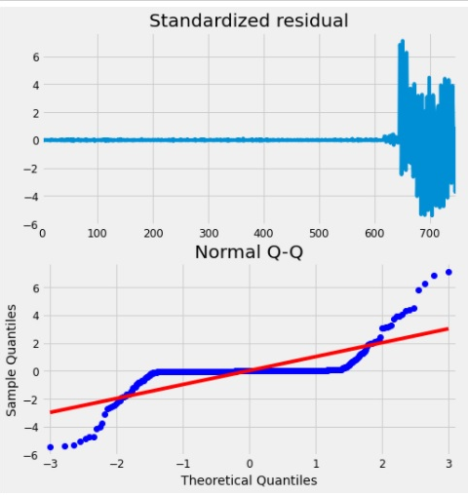
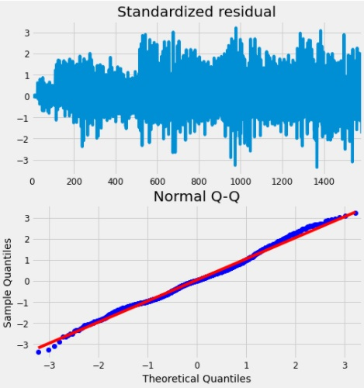
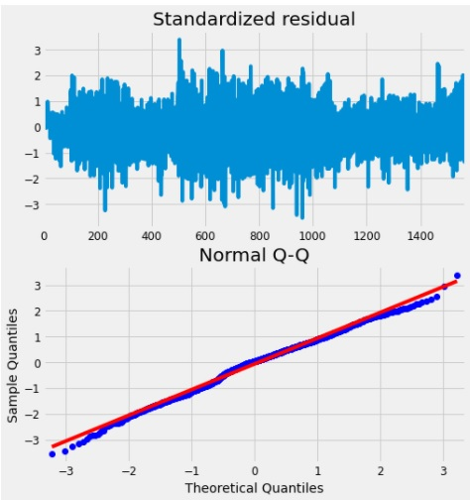
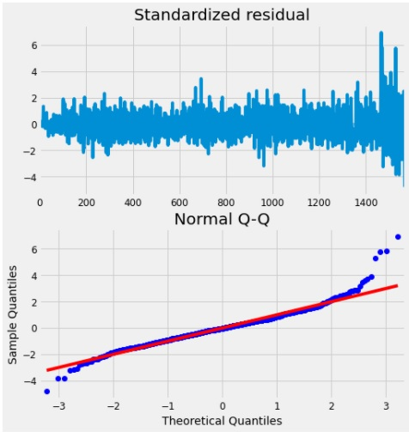
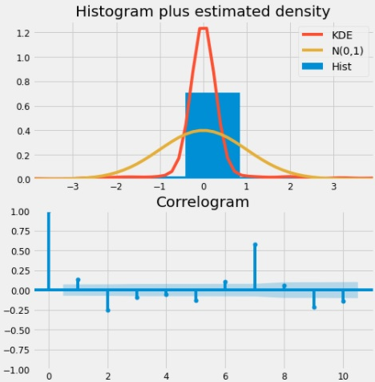
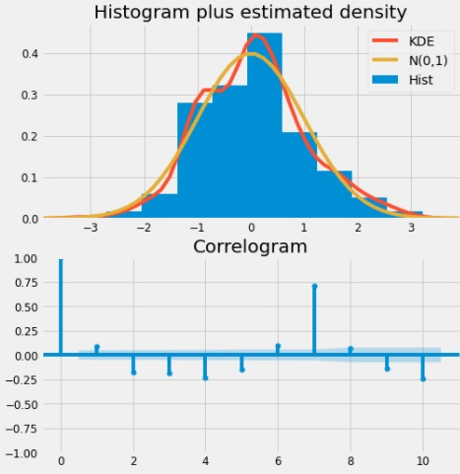
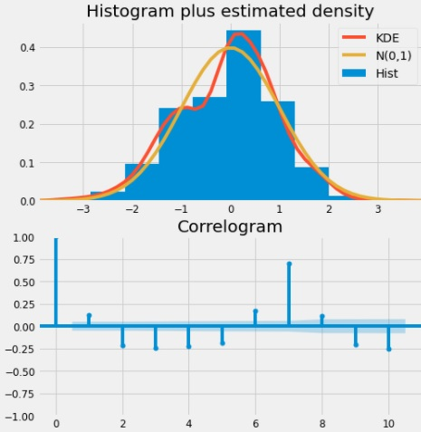
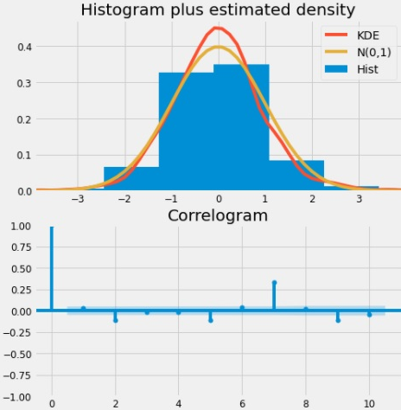
Time Series Analysis
Severity 1 Diagnostics
Severity 2 Diagnostics
Severity 3 Diagnostics
Severity 4 Diagnostics

Slide 20
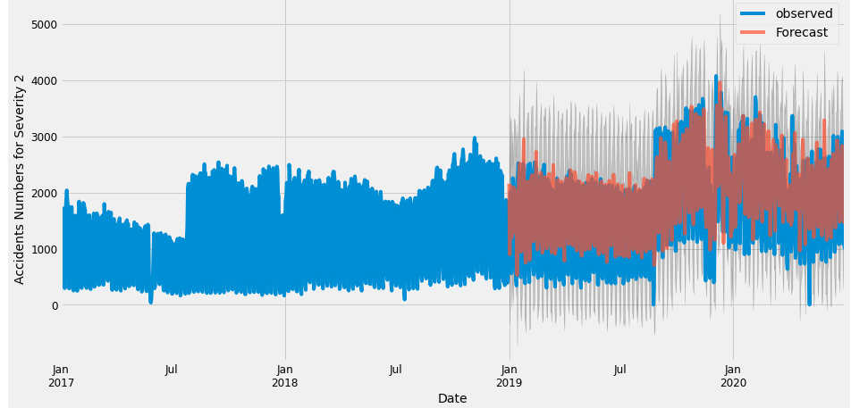
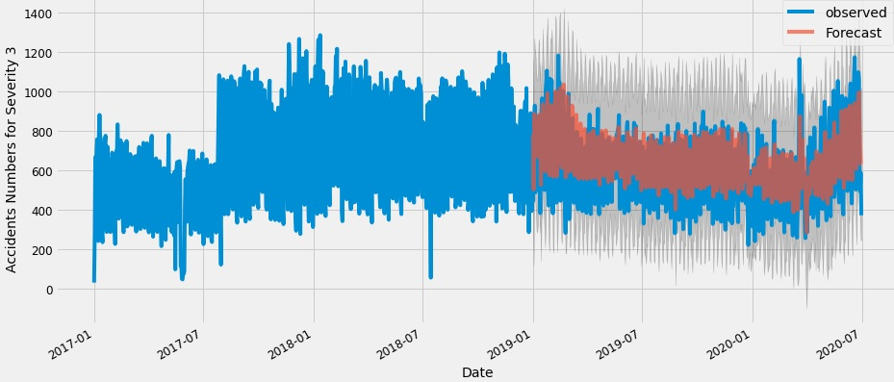
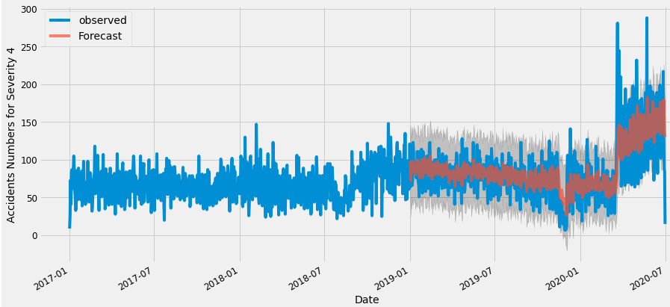
Time Series Analysis
Severity Models Validation
Due to missing a lot of days’ recordings, ARIMA model wasn’t applied to Severity 1

Slide 21
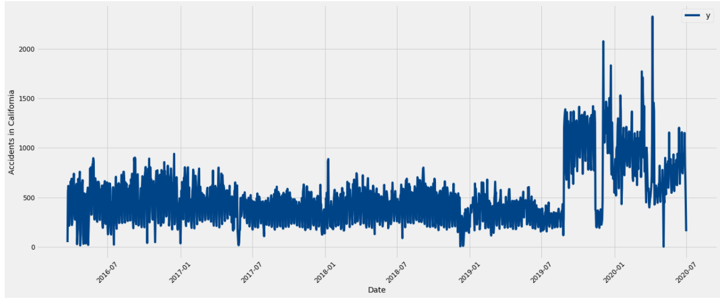
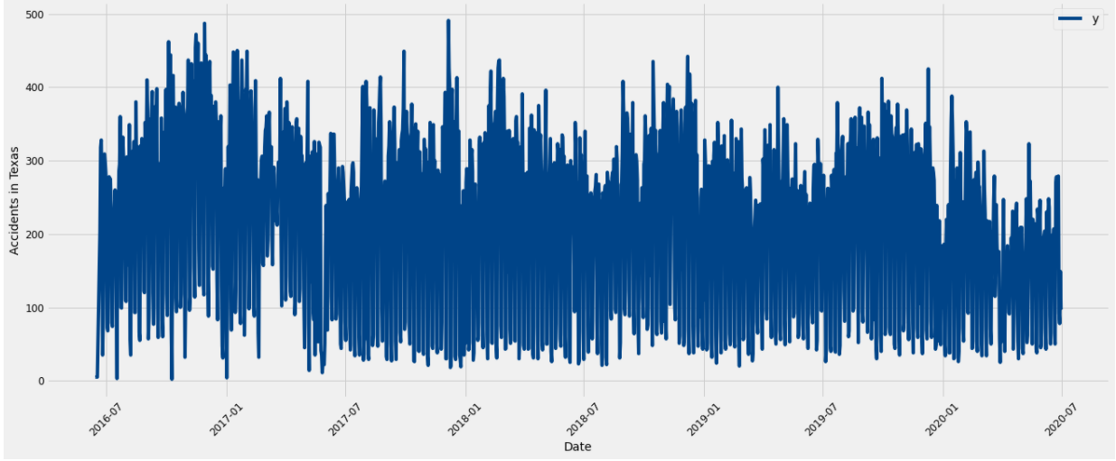
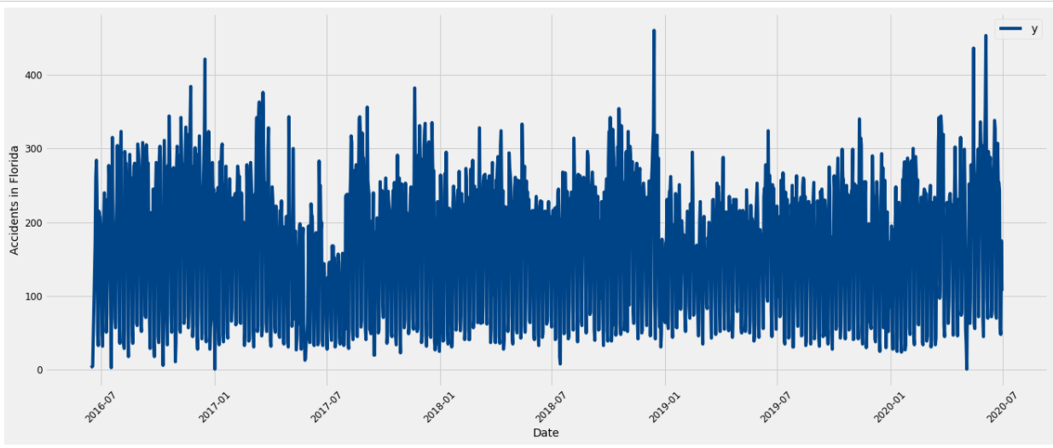
Time Series Analysis
Top 3 States:
California, Texas and Florida

Slide 22
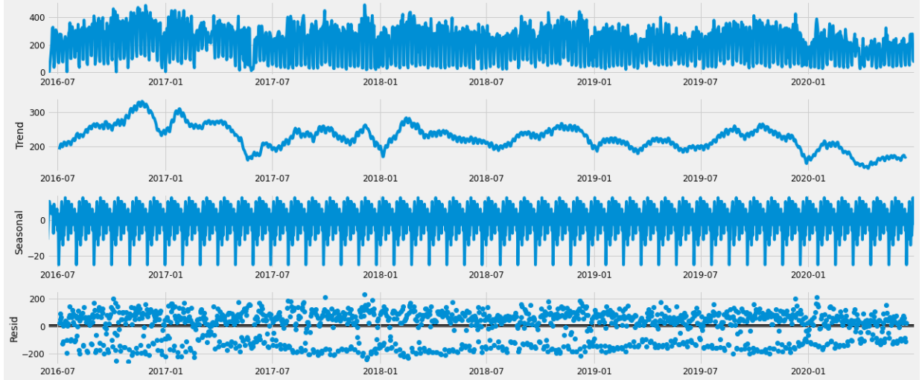
Time Series Analysis
Texas trend, seasonality & residual

Slide 23
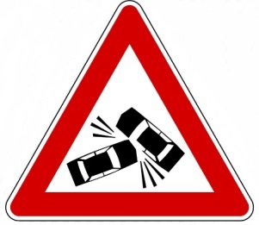
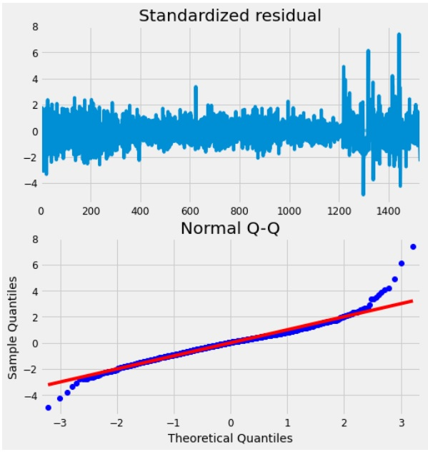
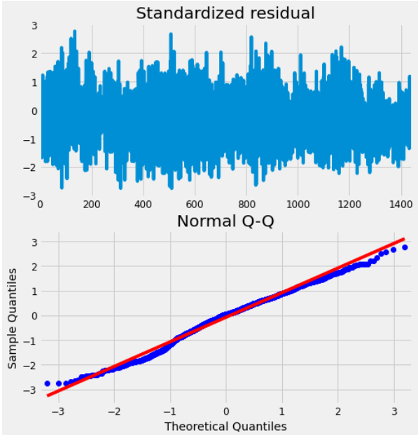
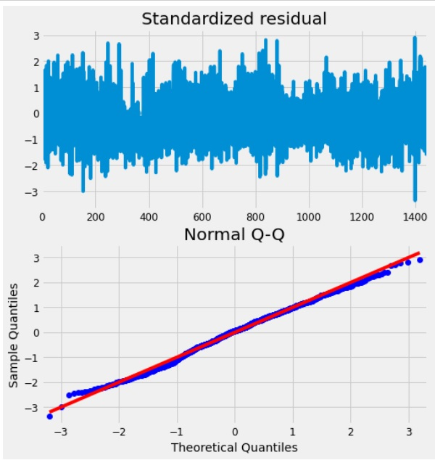
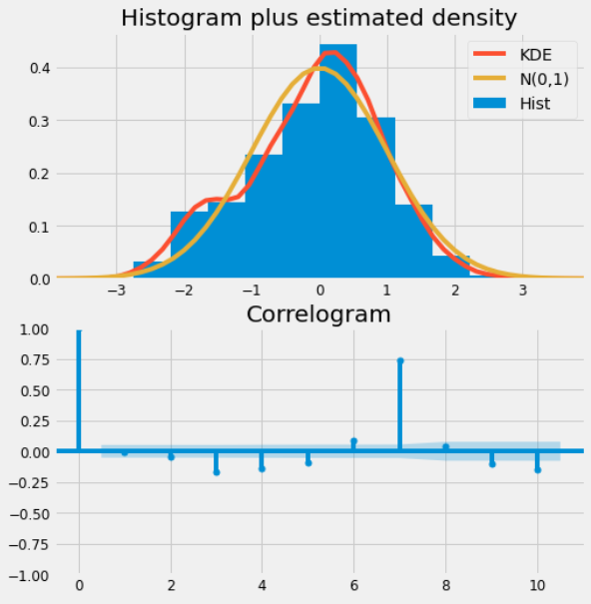
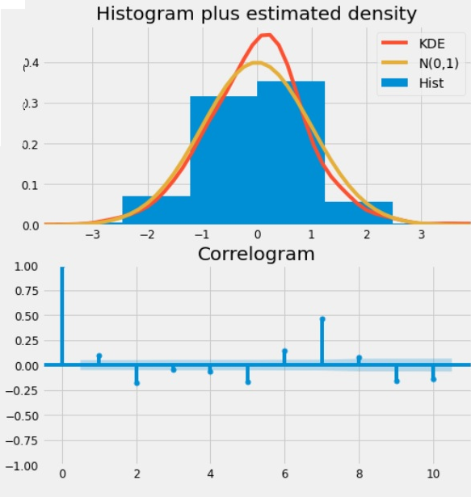
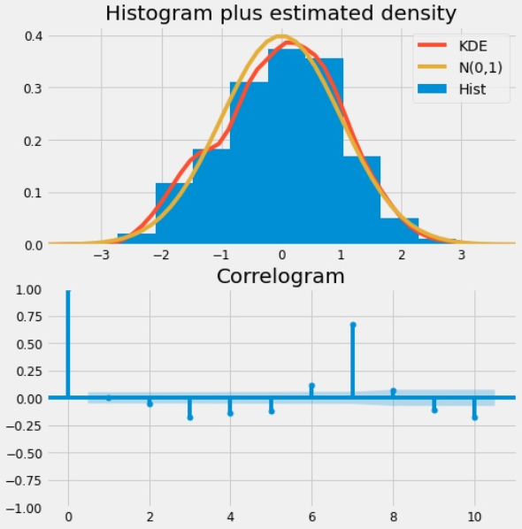
Time Series Analysis
California Diagnostics
Texas Diagnostics
Florida Diagnostics

Slide 24
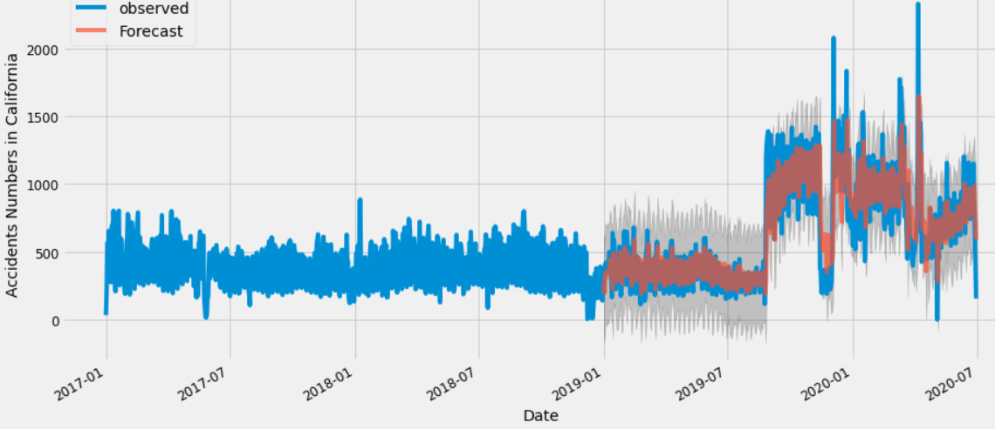
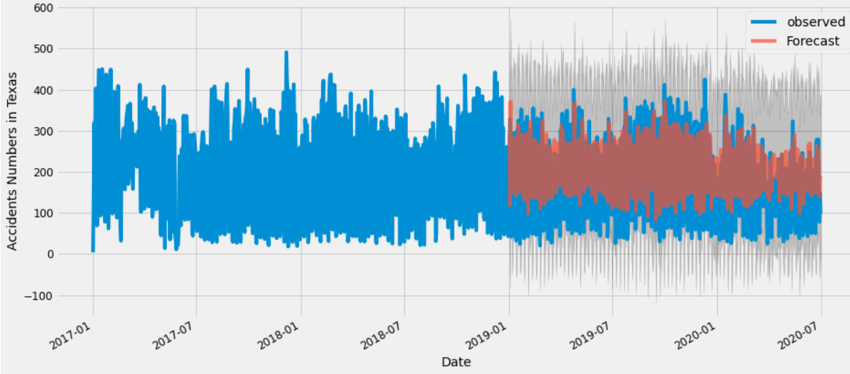
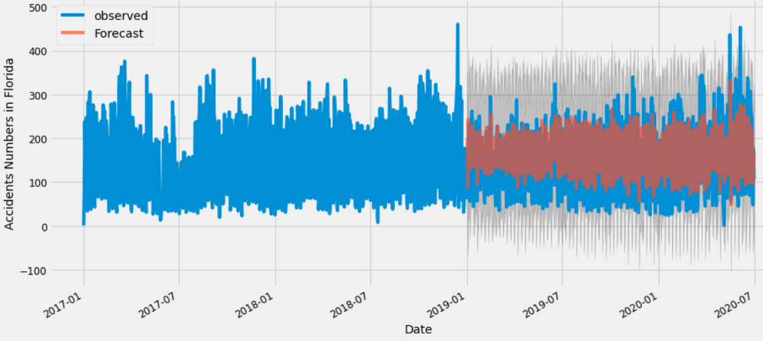
Time Series Analysis
States Models Validation

Slide 25
Time Series Analysis
Mean square error and root mean square error results
 | Date/Time |  | Total | Mean Accidents No. |  | MSE | RMSE | Error
TSA | Min | Max | Accidents No. | Min | Max |  |  | %
CA | 3/22/2016 17:44 | 6/30/2020 21:48 | 816649 | 1 | 2328 | 47137.34 | 217.11 | 5.77%
TX | 6/14/2016 20:06 | 6/30/2020 22:56 | 329283 | 2 | 491 | 8314.47 | 91.18 | 2.53%
FL | 6/14/2016 19:31 | 6/30/2020 20:22 | 258125 | 1 | 460 | 5672.4 | 75.32 | 2.20%
S1 | 2/15/2016 17:22 | 6/29/2020 20:50 | 29863 | 1 | 441 | - | - | -
S2 | 2/8/2016 5:56 | 6/30/2020 22:52 | 2374835 | 1 | 4075 | 476553.6 | 690.33 | 20.07%
S3 | 2/8/2016 0:37 | 6/30/2020 23:18 | 1001427 | 1 | 1287 | 27117.46 | 164.67 | 2.71%
S4 | 2/8/2016 21:00 | 6/30/2020 22:20 | 112519 | 1 | 2288 | 942.59 | 30.7 | 0.84%

Slide 26
Naïve Bayes US Traffic Accident Dataset:
Using Naïve Bayes Classifier to predict “Severity” of accidents from a scale of 1 to 4 on the 2018 dataset
Severity = 1 minor fender bender
Severity = 4 major crash incident
Significant Variables (12/49)
Severity (Label)
Temperature
Wind Chill/Wind Speed
Humidity
Air Pressure
Visibility
Speed bumps present?
Crossroad
Roundabout
Stop Sign
Sunset/sunrise

Slide 27
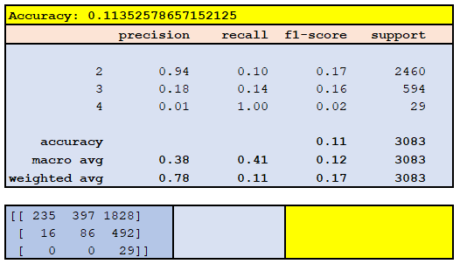
Naïve Bayes
Accuracies: 8% ~ 11%
Training set: 12k records
Severity = 1 removed due to low count
Normalized

Slide 28
Naïve Bayes
Increasing the volume of training data
Accuracies: 39% ~ 41%
Training set: 800k+ records
Results:
This type of analysis requires vast volume of data
Algorithm runs very quickly compared to other models

Slide 29
Naïve Bayes
Prediction
Points to numerous areas
County Road
Long narrow roads
Very sparse speed limit signs
Easy to go off road (especially at night time)
Prone to street racers
Recommendation:
Street lamps
Speed limit warning lights
Speed detection (Radar) signs
Widen the road
Costly

Slide 30

Weather as a Predictor
US Traffic Accident Dataset:
Variables
Visibility
Wind speed
Pressure
Wind Direction
Temperature
Wind Chill

Slide 31
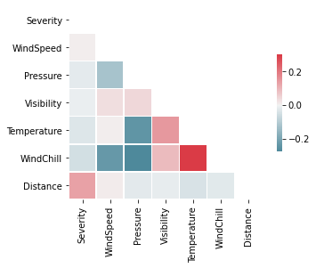
Correlation Matrix

Slide 32
Can we predict severity with weather?
City: | Adjusted R-Squared
Syracuse, NY | 0.057
Buffalo, NY | -0.003
San Francisco, CA | -0.002
Houston, TX | 0.016
Raleigh, NC | 0.035
Chicago, IL | 0.019
Amarillo, TX | 1

Slide 33
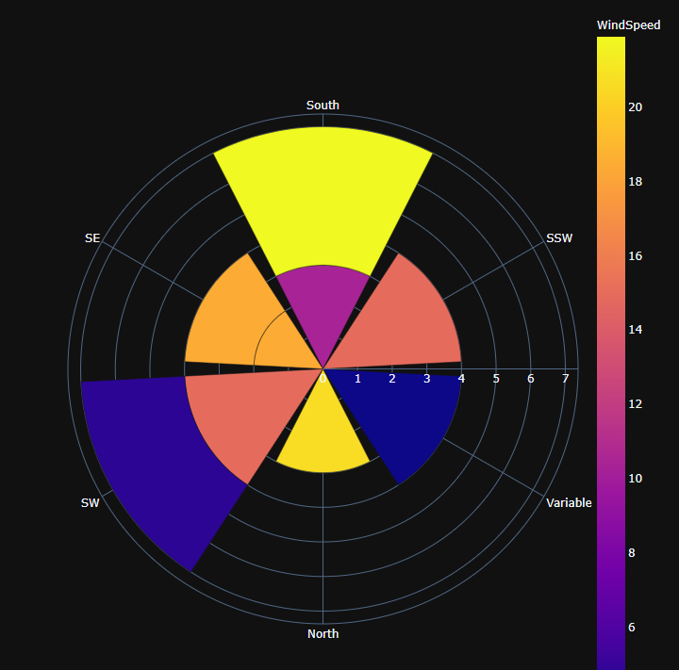
Amarillo, Tx

Slide 34
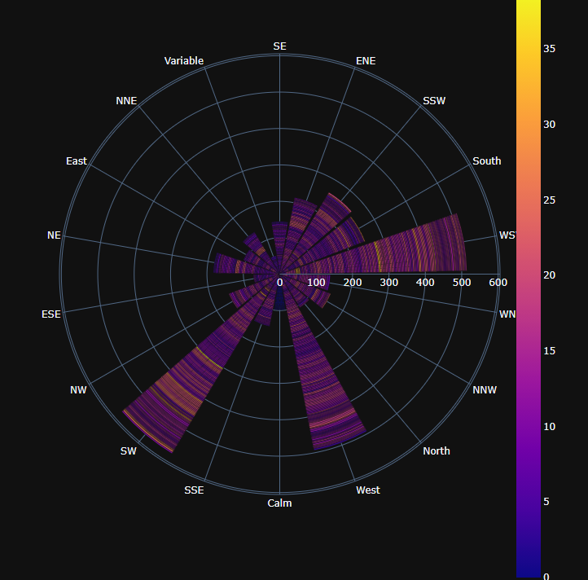
Buffalo, NY

Slide 35
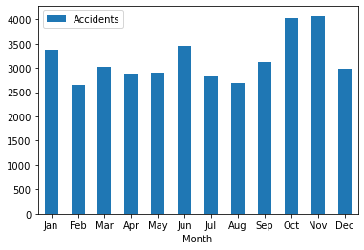
NY Accidents By Month

Slide 36
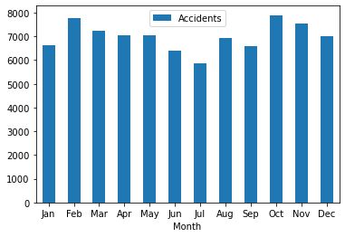
Texas Accidents By Month

Slide 37
Why Unpredictable?
Not enough data
Not enough severe weather events
How is severity determined?

Slide 38
Recommendations
Invest in advertising to reduce traffic fatalities by targeting the self-interest of drunk drivers
Further investigation needed for severities spikes, anomalies, quality of accident description in reports, and data quality issues from specific analyses in the 2020 traffic accident data
Promote pedestrian awareness for possible injury during daytime by drivers otherwise driving sober
Besides critical fields and the quality of data, a vast volume of data is also needed for certain models to increase prediction accuracy rate
Installation of street lamps, speed limit warning signs, and radar based speed displays on county roads
Additional research into efficacy of different road constructions , rules, and regulations in preventing the most severe accidents
Build other models to deeply investigate severity levels 2 & 3 to provide recommendations to bring the accidents numbers down

Slide 39
Thank You
US traffic accidents compiled from traffic monitoring services
https://www.kaggle.com/sobhanmoosavi/us-accidents
US Department of Transportation - National Highway Traffic Safety Administration (NHTSA) 2018 Fatalities
https://www.nhtsa.gov/research-data/fatality-analysis-reporting-system-fars

